Slide 1
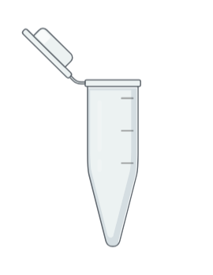

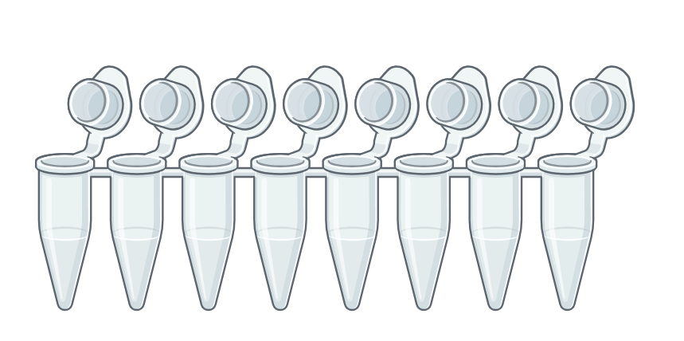
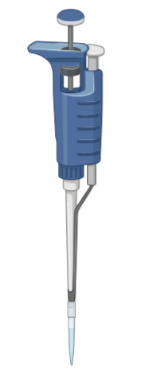
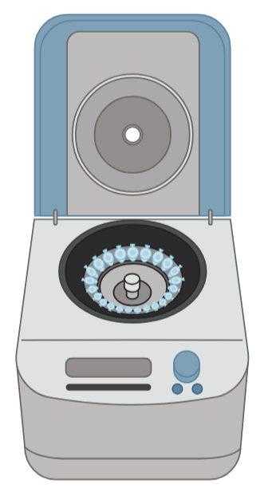
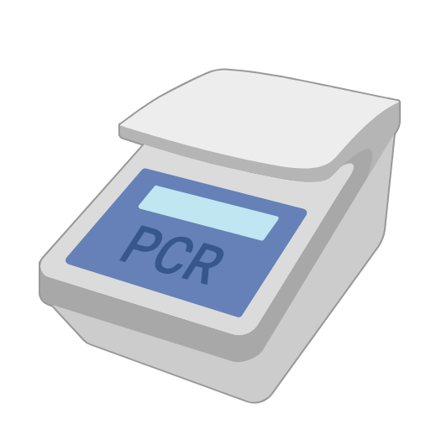
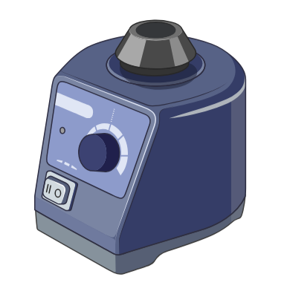
Tubes
Microcentrifuge tube
PCR tubes
Equipment
Tip
Rotor
Pipette
Vortex mixer
Centrifuge
Thermal cycler
Pipette Settings
2 µL
2 µL
14 µL
23 µL
45.5 µL
87.5 µL
2
0
0
0
0
0
0
2
1
2
4
8
0
0
4
3
5.5
7.5
P2
P20
P200
P200
P200
P200
Illustrations created with BioRender.com

Slide 2

PCR: Materials Needed
EQUIPMENT
Thermal cycler
Vortex mixer
Centrifuge
Mobile device
MATERIALS
Nitrile gloves
Squirt bottle with 70% ethanol
(12) 0.2 ml PCR tubes
Rack for PCR tubes
(2) 1.5 ml tubes
Rack for 1.5 ml tubes
Waste cup for tips
20 μl pipette & tips
200 μl pipette & tips
Sharpie, fine-tipped
Storage box for PCR tubes
Colored lab tape
Optional: Lab tray
REAGENTS
(2) DNA from arthropods (Lab 2)
(2) DNA from control arthropods (Lab 2)
(+) DNA Control
Sterile, nuclease-free water
Taq Master Mix
CO1F (Arthropod forward) primer
CO1R (Arthropod reverse) primer
WSpecF (Wolbachia forward) primer
WSpecR (Wolbachia reverse) primer
PCR PROGRAMS
Arthropod
Wolbachia
1 cycle
2 min @ 94 °C
30 Cycles
30 sec @ 94 °C
45 sec @ 49 °C
60 sec @72 °C
1 cycle
10 min @ 72 °C
Hold @ 4 °C
1 cycle
2 min @ 94 °C
30 Cycles
30 sec @ 94 °C
45 sec @ 55 °C
60 sec @72 °C
1 cycle
10 min @ 72 °C
Hold @ 4 °C
Initial Denaturation
Denaturation
Annealing
Elongation
Final Extension

