Slide 1
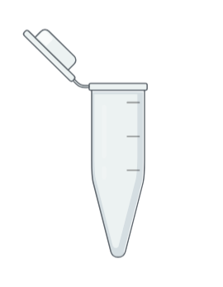

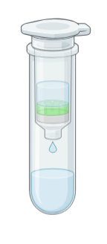
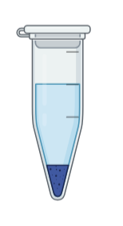
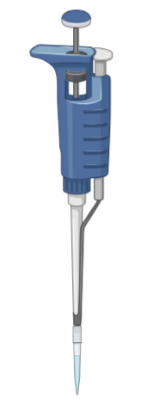
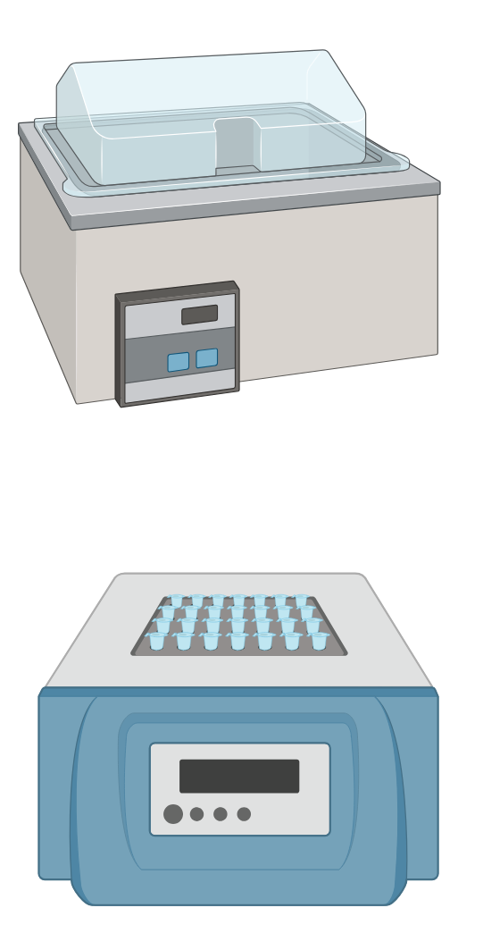
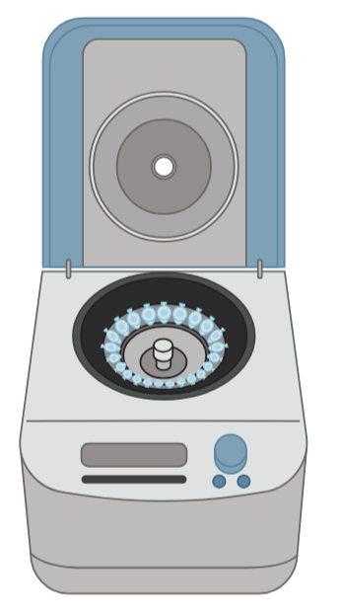
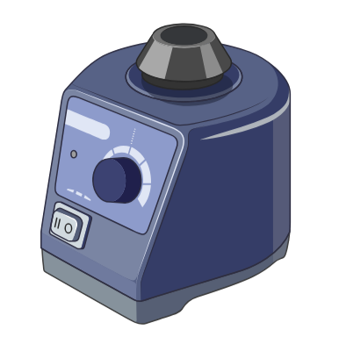
Tubes
Spin Column (membrane)
Supernatant (liquid)
Pellet (solid)
Flow Through tube
Microcentrifuge tube
Microcentrifuge tube
QIAGEN
tube
Equipment
Water bath
or
Heat block
Tip
Rotor
Pipette
Vortex mixer
Centrifuge
Incubator
Pipette Settings
20 µL
20 µL
100 µL
180 µL
200 µL
200 µL
500 µL
2
0
1
1
2
0
0
0
2
0
8
0
2
5
0
0
0
0
0
0
0
P20
P200
P200
P200
P200
P1000
P1000
Illustrations created with BioRender.com

Slide 2

DNA Extraction: Materials Needed
EQUIPMENT
Dry bath or water bath @ 56º C
Vortex mixer
Centrifuge
Mobile device with camera
MATERIALS
Nitrile gloves
Sharpie, fine-tipped
Squirt bottle with 70% ethanol
Dissection kit
Water – squirt bottle or transfer pipette
Rack for 1.5 ml tubes
(4) Microtube pestles
(12) 1.5 ml tubes
200 μl pipette & tips
1000 μl pipette & tips
Waste cup for solids
Storage box for 1.5 ml tubes
Colored lab tape
Paper towels
Optional: Lab tray
REAGENTS
(2) Student-collected arthropods (Lab 1)
(2) Arthropod controls
Ethanol (>800 μl per group)
QIAGEN DNEASY KIT (#69504)
Qiagen Buffer ATL
Qiagen Proteinase K
Qiagen Buffer AL
Qiagen Buffer AW1
Qiagen Buffer AW2
Qiagen Buffer AE
(4) Qiagen spin columns
(4) Qiagen collection tubes

