Slide 1
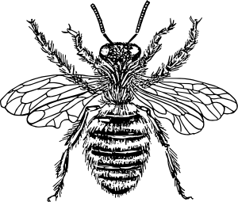
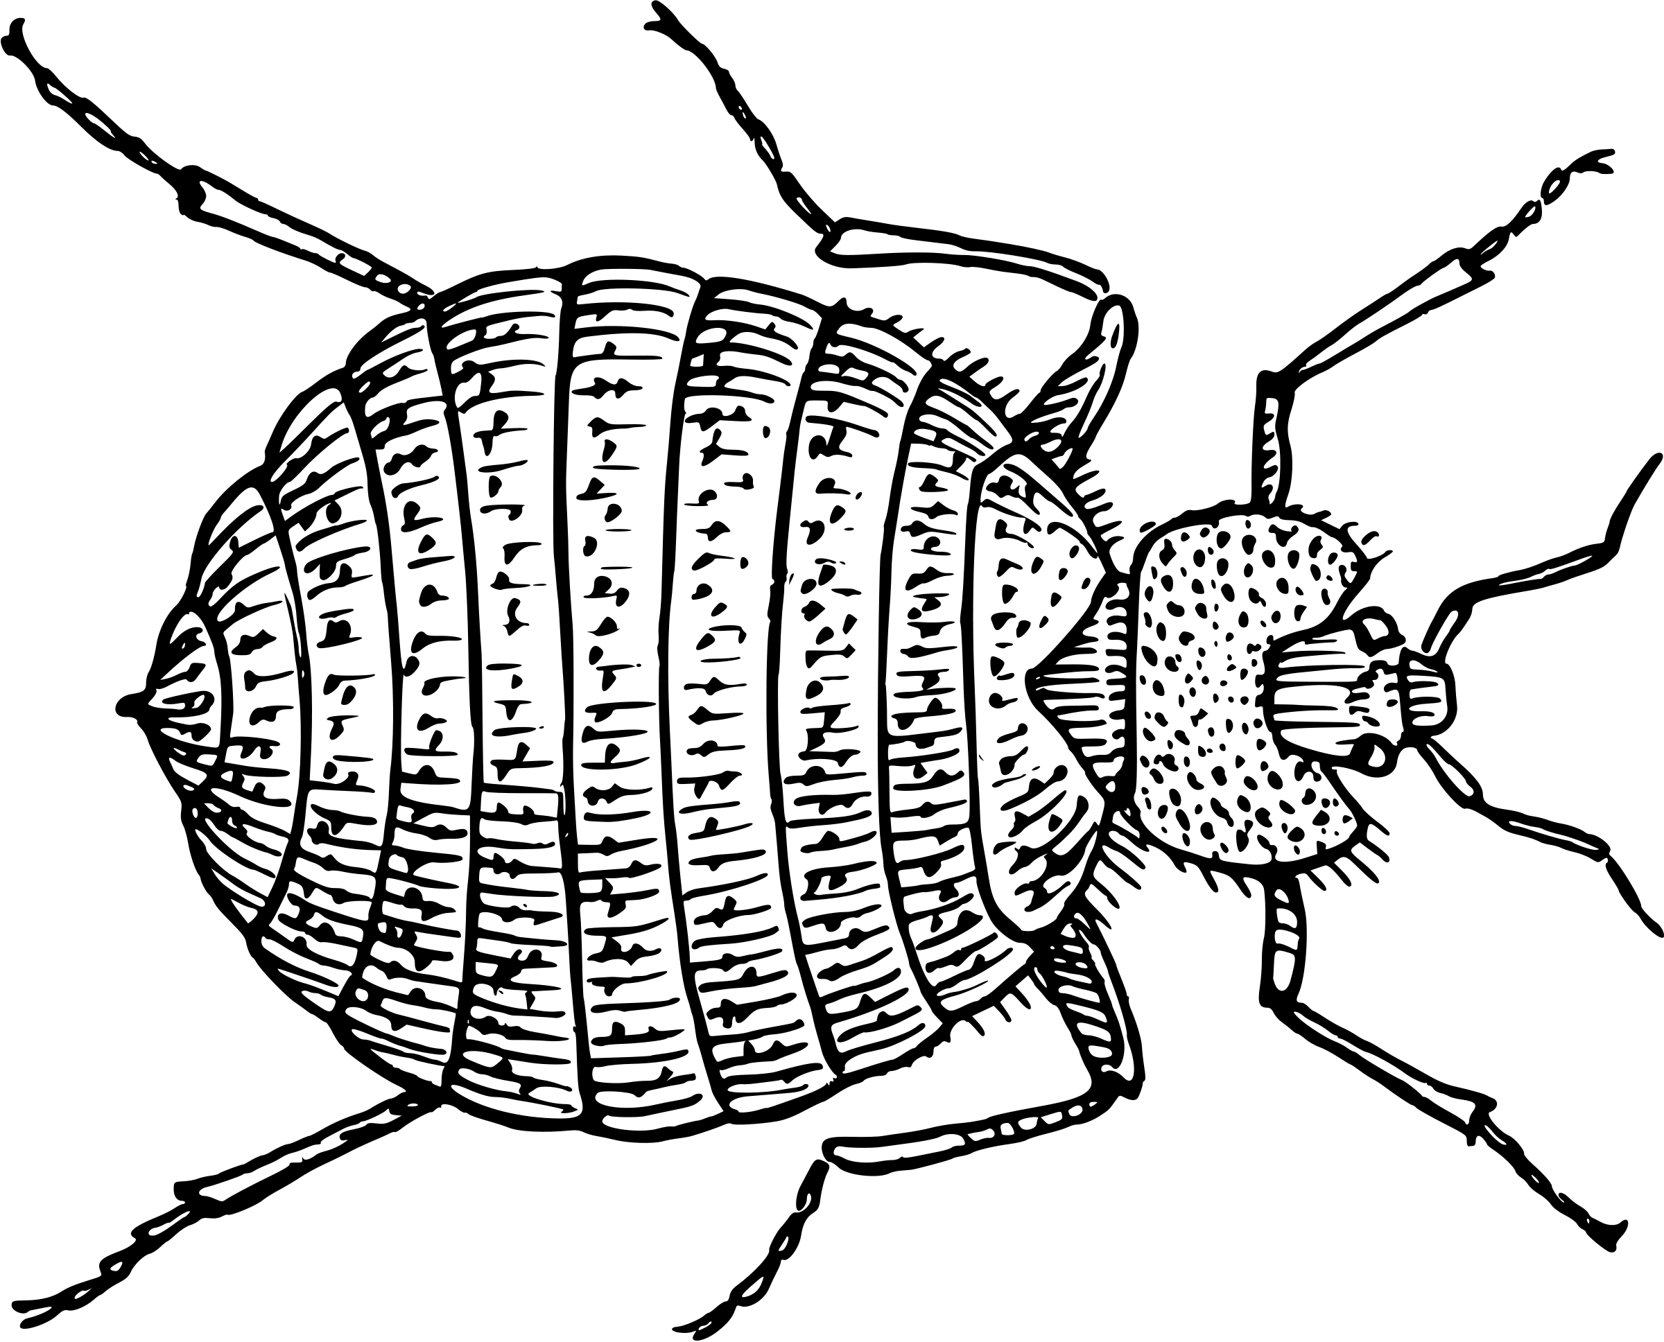
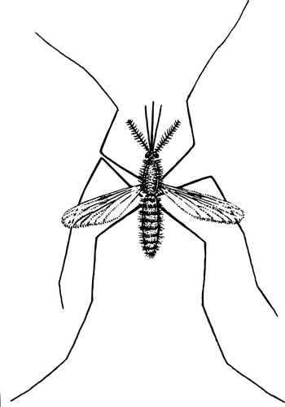
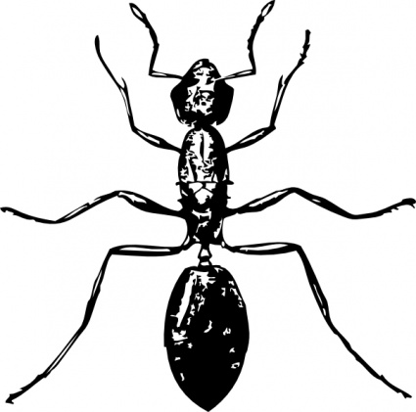
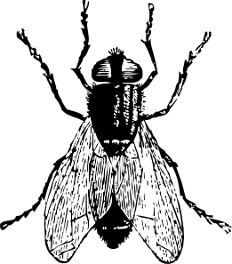
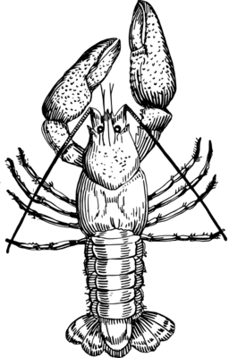
Updated: March 2022
Lab 2: DNA Extraction
Edward’s Buffer
Student Guide

Slide 2
The Wolbachia Project
1
Arthropod Identification
2
DNA Extraction
3
PCR
4
Gel Electrophoresis
5
Bioinformatics
Content is made available under the Creative Commons Attribution-NonCommercial-No Derivatives International License. Contact (info@wolbachiaproject.org) if you would like to make adaptations for distribution beyond the classroom.
The Wolbachia Project: Discover the Microbes Within! was developed by a collaboration of scientists, educators, and outreach specialists. It is directed by the Bordenstein Lab.
https://www.wolbachiaproject.org
LAB 2: DNA EXTRACTION

Slide 3
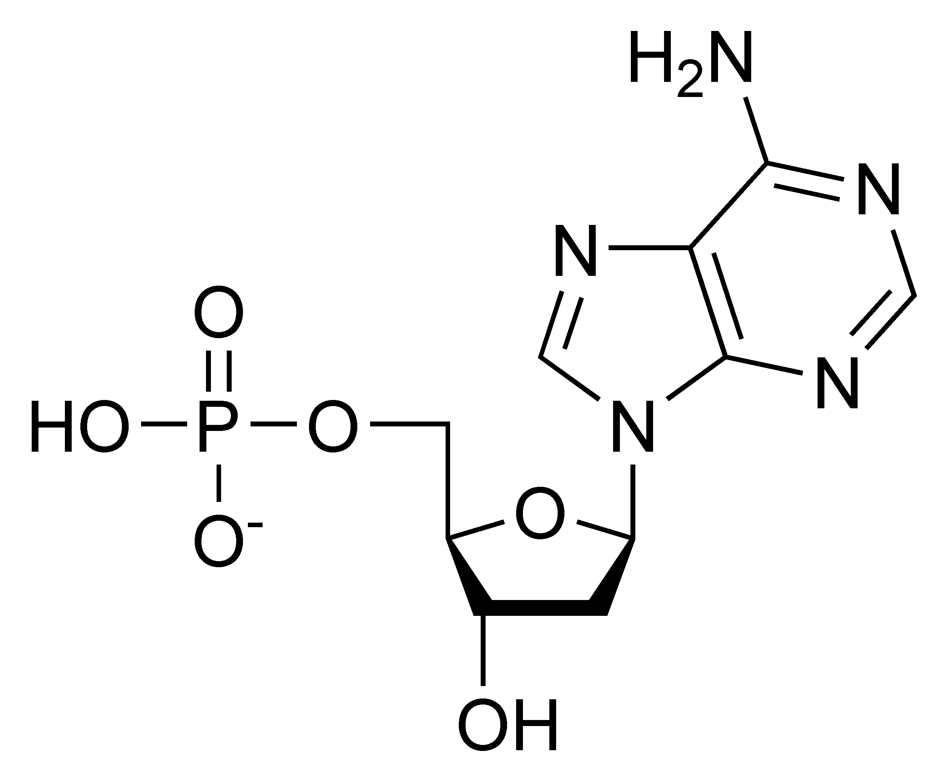
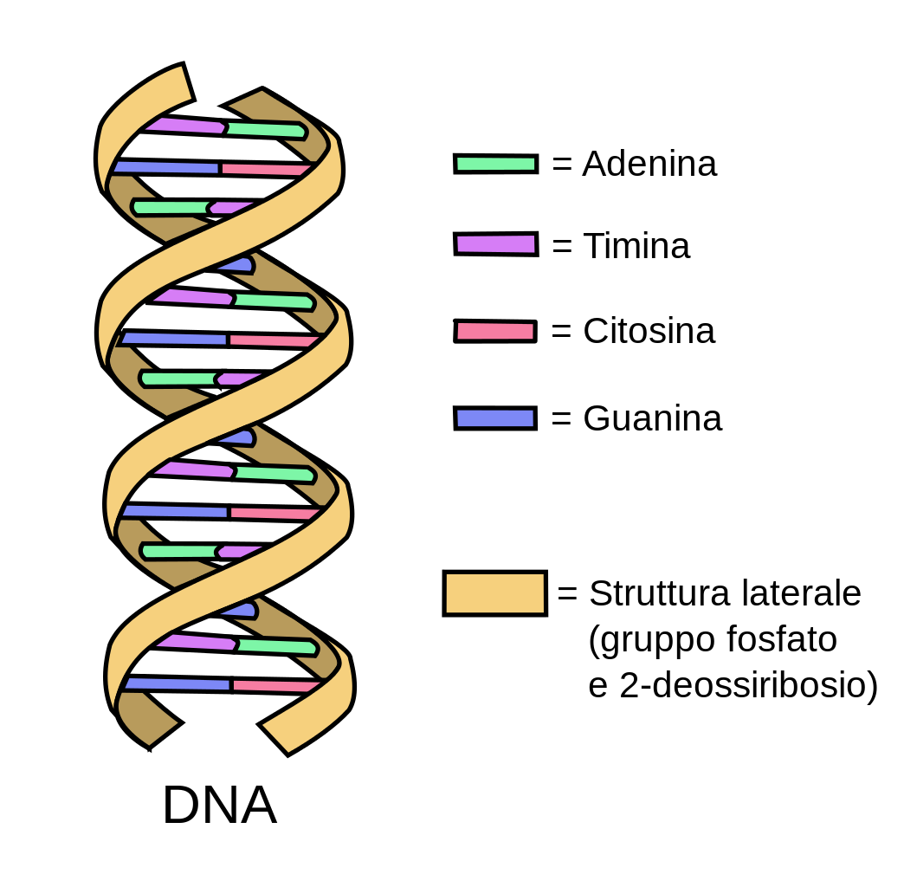
Introduction to DNA
DNA Composition
Deoxyribonucleic acid, or DNA, is a self-replicating molecule that encodes the genetic information for nearly all living organisms. DNA is comprised of monomers, called nucleotides. Each nucleotide consists of (i) a five-carbon sugar (deoxyribose), (ii) a phosphate group, and (iii) a nitrogenous base (Figure 2.1). Nucleotides are differentiated by their attached nitrogenous base: adenine, thymine, guanine or cytosine. Adenine and guanine are classified as purines; cytosine and thymine are classified as pyrimidines. The nucleotides are linked together via phosphodiester bonds to form long strands of DNA, where the order of nucleotides along the sugar-phosphate backbone determines the DNA sequence.
DNA Structure
A single strand of DNA is asymmetrical and therefore has a specific method of combining with a second strand of DNA. The sugar and phosphate group are both hydrophilic and will readily come into contact with water molecules within a cell, whereas the nitrogenous bases are hydrophobic and will aggregate together. Two strands of DNA can satisfy their hydrophilic and hydrophobic constraints by orienting their nitrogenous bases to the inside and their hydrophilic sugars and phosphate groups to the outside. The nitrogenous bases are held together by hydrogen bonds, which maintain the shape of the DNA ladder. These base pairs are formed when a pyrimidine binds with a purine. Specifically, adenine forms a base pair only with thymine via two hydrogen bonds, and cytosine forms a base pair with only guanine via three hydrogen bonds (Figure 2.1). A skew and a twist of the strands of DNA lets in as little water as possible between the nitrogenous bases, forming the well-known double helix shape of the double stranded DNA (dsDNA) molecule.
Figure 2.1
Adenine (A)
Left: Nucleotide structure consisting of phosphate group, sugar (deoxyribose), and nitrogenous base.
Thymine (T)
Cytosine (C)
Nitrogenous base
(Adenine)
Guanine (G)
Phosphate group
Right: DNA double helix structure consisting of a hydrophilic sugar-phosphate backbone and hydrophobic nitrogenous base pairs.
Sugar- phosphate backbone
5-carbon Sugar (Deoxyribose)
Image from Wikimedia Commons; available in public domain.
Image modified from Wikimedia Commons/Forluvoft; available in public domain.
LAB 2: DNA EXTRACTION

Slide 4
Cellular DNA
Eukaryotic chromosomes
Prophage WO DNA
Phage WO DNA
Bacterial chromosome
Nucleus
Wolbachia
Mitochondrial DNA
Mitochondria
Figure 2.2. A eukaryotic cell containing nuclear DNA (yellow), mitochondrial DNA (green), bacterial DNA (blue) and bacteriophage DNA (red).
Arthropod cells may contain multiple types of DNA (Figure 2.2).
Nuclear DNA: Eukaryotic DNA is coiled and condensed around nuclear proteins, called histones, to form chromosomes. Chromosomes are stored in the nucleus of each cell and encode the arthropod’s genetic information.
Mitochondrial DNA: Mitochondria, the organelle responsible for cellular respiration and energy production, contains its own DNA. Mitochondrial DNA is circular and, like its encoding organelle, is passed down from mother to offspring.
Bacterial DNA: Wolbachia and other bacterial endosymbionts contain a single, circular, supercoiled DNA molecule called the bacterial chromosome.
Bacteriophage DNA: Phage WO, the bacteriophage that infects Wolbachia, carries its own genome. Phage WO is a temperate phage and can replicate using both lytic and lysogenic cycles. In the lysogenic cycle, WO integrates its genome into the bacterial chromosome and is referred to as Prophage WO. When active, WO packages its genome into phage capsids and is referred to as Phage WO. Therefore, an arthropod cell may contain phage DNA and/or prophage DNA depending on the phage life cycle.
In addition to the DNA shown above, an arthropod cell may also contain eukaryotic viruses and other intracellular bacteria (e.g., Rickettsia, Spiroplasma, Cardinium).
LAB 2: DNA EXTRACTION

Slide 5
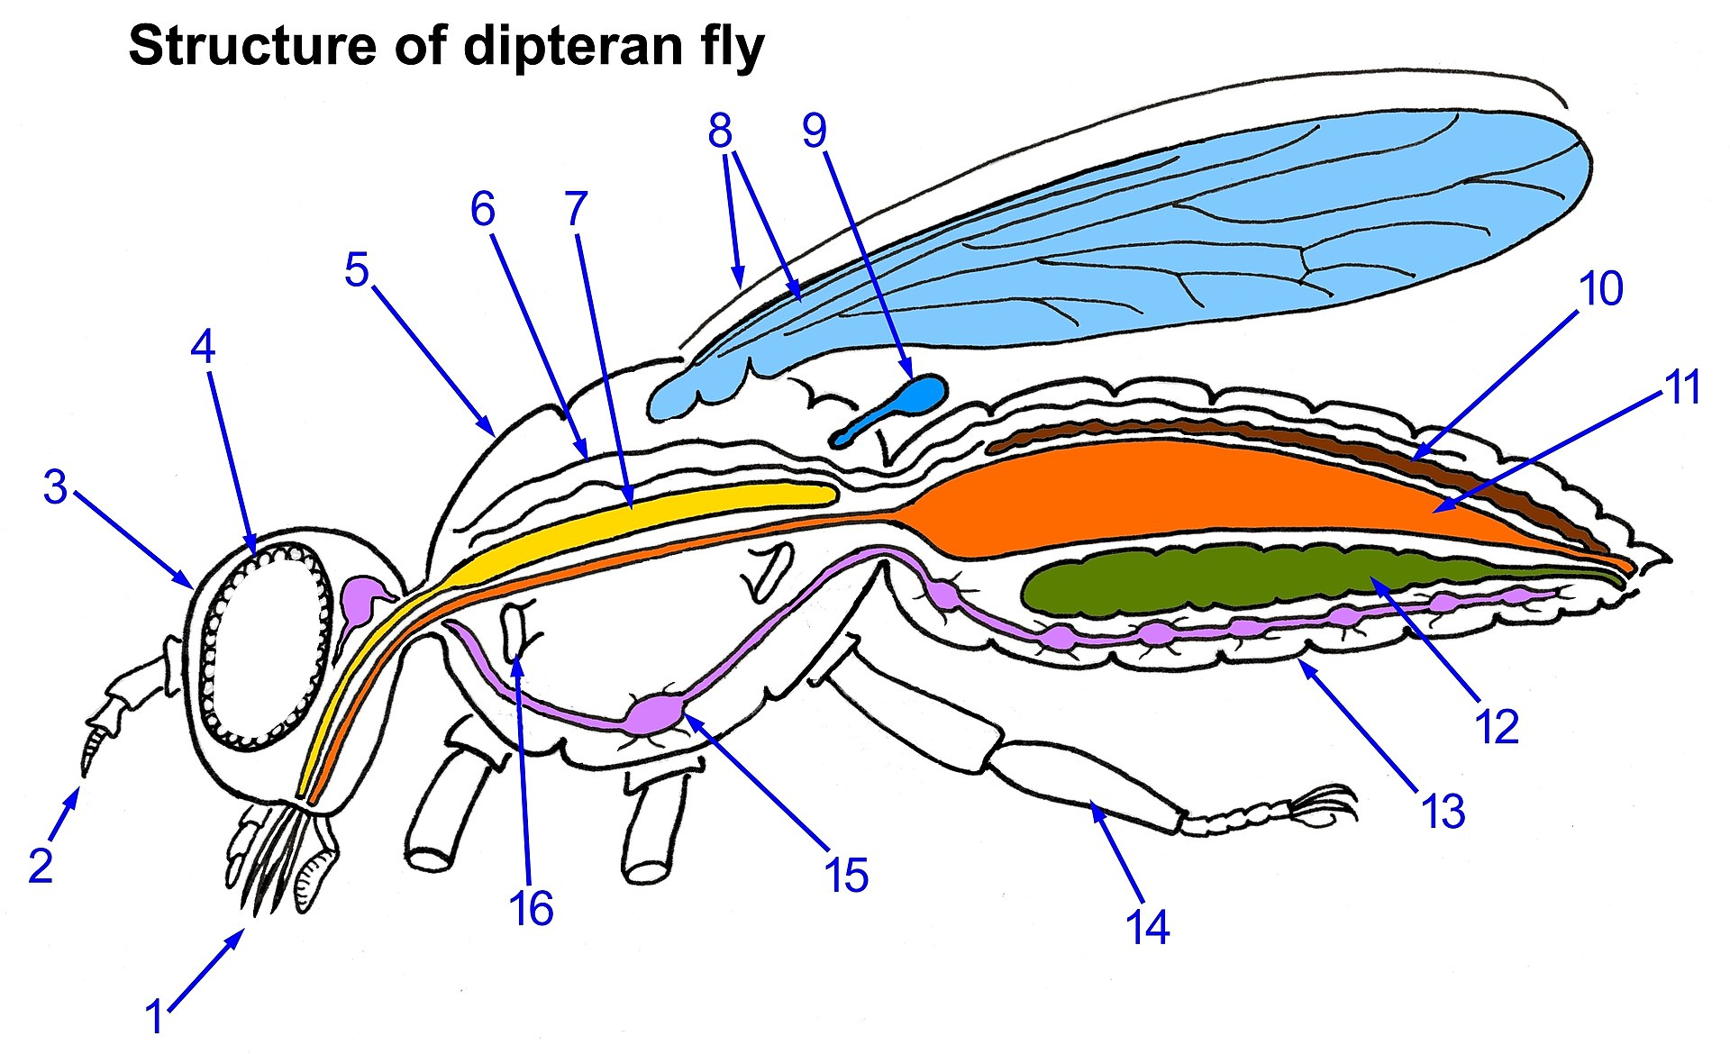
Wolbachia Localization
In most cases, whole body DNA extractions are sufficient to obtain Wolbachia DNA. If a specimen is particularly large and/or has a tough exoskeleton, abdominal dissections are recommended. A general rule of thumb is to dissect specimens that are larger than a grain of rice, such as a fruit fly, small ant, or mosquito. Because Wolbachia is maternally transmitted, it is commonly localized in the reproductive organs (ovaries and testes); however, increasing studies have also detected the symbiont in somatic, non-reproductive tissue. For the purpose of this lab activity, we recommend dissecting the reproductive areas. Make sure the arthropod is not still alive; freezing overnight and/or preserving in alcohol should be done prior to dissections and DNA extraction.
General guidelines for Wolbachia DNA extractions:
Small arthropods: If the specimen is about the size of a fruit fly or small ant (~2 mm), extract DNA from the entire body.
Large arthropods: If the specimen is larger than ~2 mm, use a scalpel or razor blade to cut off the abdomen. In many cases, such as grasshoppers and cockroaches, the abdomen may still be larger than 2 mm. If so, use the scalpel to extract a portion of the abdomen most likely to contain reproductive tissue. The anatomy of a Dipteran fly is shown below for reference (Figure 2.3). It is recommended to research the anatomy of each arthropod prior to dissections.
Tough arthropods: If the specimen has a particularly tough exoskeleton, such as a tick, use a scalpel or razor blade to carefully cut open the abdomen and expose internal organs. This will ensure that the cell lysis buffer has access to reproductive tissues.
Open heart tube
Wings
Halter
Salivary gland
Excretory (Malpighian) tube
Thorax
Compound eye
Gut
Head
Ovary (or Testis)*
Paired antennae
Thoracic ganglion of nervous system
Abdomen
Spiracle opening to respiratory tube (trachea)
Legs
Complex mouthparts
* Wolbachia-enriched
Figure 2.3. Dipteran fly anatomy
Image by Daktaridudu; available in Wikipedia under CC BY-SA 4.0 license
LAB 2: DNA EXTRACTION

Slide 6
Technical Overview
This DNA extraction protocol is based on a widely used cell lysis technique described in Edwards et al., 1991 (below). The purpose of each step is outlined below.
Sample Preparation
Each specimen will be rinsed with water to remove alcohol preservative. If larger than a fruit fly, the abdomen will be dissected to obtain the reproductive tissues. If the specimen contains a particularly tough exoskeleton, abdominal tissue can be exposed using a scalpel or razor blade.
Cell Lysis
Each specimen will be macerated in a cell lysis solution, called Edwards Buffer, to break open the cellular and nuclear membranes. As a result, DNA is exposed to proteases, such as nucleases, in the host tissue. Therefore, the cell lysis buffer contains the following components to both lyse the cell and inhibit proteases:
EDTA – Destabilizes the cell membrane; inhibits nuclease activity
SDS – Disrupts membranes and denatures proteins
NaCl – Removes proteins from DNA; keeps proteins and SDS solubilized to avoid co-precipitation with DNA
Tris – Maintains pH of the lysis buffer; aids in membrane destabilization
Cellular Debris Removal
In order to obtain purified DNA, cellular debris will be removed via centrifugation. At this point, the DNA is solubilized in lysis buffer and will remain in the supernatant.
DNA Precipitation & Purification
This protocol includes both an isopropanol precipitation and ethanol wash. Cold isopropanol will precipitate the DNA quickly while an ethanol wash will displace excess salts and other alcohol soluble biomolecules. The ethanol wash will also decrease the time needed to air dry the DNA pellet. Prior to elution, it is important to remove both isopropanol and ethanol because they can interfere with PCR reactions.
DNA Elution
The DNA elution buffer will solubilize genomic DNA and protect it from degradation. For most laboratory assays, including PCR, a TE-based buffer is preferred over water because it solubilizes DNA more rapidly and protects against (i) multiple freeze-thaw cycles and (ii) nucleases. Because TE contains EDTA, however, it may inhibit downstream Sanger sequencing. Therefore, PCR products intended for DNA sequencing reactions should be suspended in nuclease-free water.
Reference
Edwards, K., Johnstone, C. & Thompson, C. A simple and rapid method for the preparation of plant genomic DNA for PCR analysis. Nucleic Acids Research 19, 1349 (1991).
LAB 2: DNA EXTRACTION

Slide 7
Pre-Lab Questions
Read through the entire protocol and answer the questions below.
Based on your knowledge of DNA structure, what is the complementary strand of this DNA sequence?
Is it possible for your DNA extraction to contain only Wolbachia DNA? Explain why or why not.
List the two controls used in this experiment. If we already have control DNA for PCR, why do we need controls at this stage?
Which centrifuge rotor(s) is properly balanced?
How would you properly balance the other rotor(s)?
What would happen if you used the same pipet tip throughout the entire protocol?
5’ – ATG CCG GAA TCG TTA GCA – 3’
8
1
2
8
1
2
8
1
2
7
3
7
3
7
3
6
5
4
6
5
4
6
5
4
A
B
C
LAB 2: DNA EXTRACTION

Slide 8
DNA Extraction Protocol
Class Materials
Water bath, 95 °C
Vortexer (optional)
Mini-centrifuge (10,000 x g)
Float rack
Metal tongs
Ice bucket or cooler
Materials per Group
2 Arthropod specimens
+/- Drosophila controls
Distilled water
Gloves
Kimwipes (or paper towels)
Petri dish
Dissecting tools (tweezers/scalpel)
Cell lysis buffer
DNA elution buffer
Isopropanol, cold
70% Ethanol
1.5 ml microcentrifuge tubes
Tube rack
Sterile pestles
Pipette (20-200)
Pipette tips
Waste cup for tips
Waste cup for liquids
Sharpie
Paper towels
Parafilm
Note 2.1: DNA precipitates in the presence of alcohol. Therefore, remove as much preservative as possible. If the arthropod is large or has a thick/tough exoskeleton, dissect out the reproductive tissues.
Sample Preparation
Use tweezers to carefully transfer the arthropod to a Petri dish.
Rinse with water using either a squirt bottle or a 20-200 ul pipette.
Blot dry excess liquid. (See Note 2.1)
Remove the abdomen of the insect and cut off a small piece (roughly ~2 mm, or small enough to fit in the bottom of a microcentrifuge tube). If the specimen is smaller than a grain of rice, use the entire body.
Place the specimen in a labeled 1.5 ml microcentrifuge tube.
Cell Lysis
Add 100 ul Cell Lysis Buffer to the first tube.
Use a sterile pestle to grind the sample for 1 minute. (See Note 2.2)
Add an additional 100ul of Cell Lysis Buffer. Grind a few more times, then dip the pestle in the arthropod lysate to rinse and remove remaining debris. Change pestle and pipet tip; move on to the next sample and repeat Steps 6-8.
Heat samples @ 95° C for 5 minutes. (See Notes 2.3 & 2.4)
Wrap the caps with Parafilm to prevent lids from popping off while heating.
Place each of the tubes into a foam rack and place the rack directly in the beaker of hot water.
Use tongs or a long metal rod to remove the rack from the hot water.
Cellular Debris Removal
Place tubes in ice bucket or refrigerator to cool to room temperature.
Vortex tubes for 20 seconds. If you do not have a vortexer, mix tubes by tilting back and forth ~ 50 times. This can be done with the microcentrifuge tubes still in the foam carrier (or in a tube rack) by placing one hand on the top and one on the bottom and gently inverting.
Centrifuge for 2 minutes to pellet debris. (See Note 2.5)
Samples should be small enough to fit in the bottom of a tube.
Note 2.2: This is the most critical step of the entire protocol. Thorough grinding is necessary in order to obtain high DNA yield. Use muscle power and grind each sample thoroughly.
Use a clean pestle for each arthropod.
Note 2.3: Do not over-boil. Extended incubation at 95° C can lead to denaturation and degradation of DNA.
Note 2.4: While samples are incubating, label new tubes containing 150 ul cold isopropanol in preparation for Step 13.
Keep water boiling during incubation.
Note 2.5: Always keep the centrifuge balanced! Space samples evenly across the rotor. If unable to properly balance the rotor, fill a labeled tube with water and use it as a balancer.
Centrifuge at 10,000 x g or use the default high speed.
This protocol was adapted and modified for The Wolbachia Project; it is made available under CC-BY-NC-ND.
LAB 2: DNA EXTRACTION

Slide 9
DNA Extraction Protocol
Note 2.6: If you disturb the pellet, repeat step 12. If you are unable to collect 150 ul, add 50-100ul additional lysis buffer to the tube and repeat steps 11-12.
DNA Precipitation & Purification
Use a pipet to carefully transfer 150 ul of supernatant to a new tube containing an equal amount (150 ul) of cold isopropanol. (See Note 2.6)
Gently mix samples by inverting approximately 50 times.
Centrifuge for 5 minutes to pellet genomic DNA. (See Note 2.7)
Carefully pour the supernatants into a waste cup and invert tubes on a paper towel to air dry for 1 minute. Be careful not to reinvert the tubes prior to placing them on the paper towel as this could cause ethanol to flow back against, and possibly dislodge, the pellets.
Add 100 ul of 70% ethanol to each pellet.
Invert tubes 10 times to wash the DNA.
Centrifuge for 1 minute.
Carefully pour off the supernatants and invert tubes on a clean paper towel to air dry for about 10 minutes. (See Note 2.8)
DNA Elution
Add 50ul of TE Buffer to each tube.
Recommended: Re-hydrate DNA by incubating samples at 65 °C for up to 1 hour or overnight at room temperature. If there is still a tight pellet at bottom of tube, vortex or use pipette tip to dislodge. Mix into solution before moving on to PCR step.
Storage
Store at 4 °C for a few weeks or -20 °C indefinitely.
This is an optional STOPPING POINT. Store DNA in freezer (-20 °C) until next class period.
Note 2.7: To easily locate the pellet, orient the hinge of the tube to point away from the middle of the centrifuge. The DNA pellet may be seen near the bottom of the tube under the hinge.
Note 2.8: Pellet may be loose so watch carefully and pour slowly. If the pellet begins to dislodge, add more ethanol and re-spin.
Allow residual ethanol to drain and/or evaporate from each tube.
Helpful Tips
The DNA pellet may not be visible by step 16—that is OK. Continue with the procedure and the pellet will become more visible by step 20. It should appear as a small white dot under the hinge of the microcentrifuge tube. You may have to hold the tube up to the light in order to see the pellet.
To ensure optimal results:
Grind, grind, grind!
Avoid contamination by changing tips between each reagent, sample.
Keep the rotor balanced.
This protocol was adapted and modified for The Wolbachia Project; it is made available under CC-BY-NC-ND.
LAB 2: DNA EXTRACTION

Slide 10
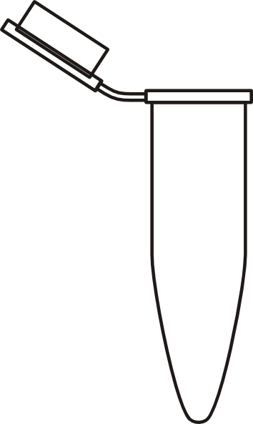
Post-Lab Questions
Illustrate the contents of each tube upon completion of the following steps. Below, label where the DNA is located.
After completion of the DNA precipitation stage, describe the visual appearance of the DNA.
Where is Wolbachia located within an arthropod? Why?
What is the purpose of isolating the DNA? What is your next step in determining the frequency of Wolbachia?
Imagine that there is an E. coli outbreak in your state and you would like to test the lettuce from your local grocery store. How could you modify this protocol in order to extract DNA from the lettuce (to identify the species) and check for presence/absence of E. coli. ? Keep in mind that (i) E. coli is free-living and not an endosymbiont, and (ii) plant cells are encased in both a cell membrane and cell wall.
Sample Preparation
Cell Lysis
Cellular Debris Removal
DNA Precipitation
DNA Elution
LAB 2: DNA EXTRACTION

