Slide 1
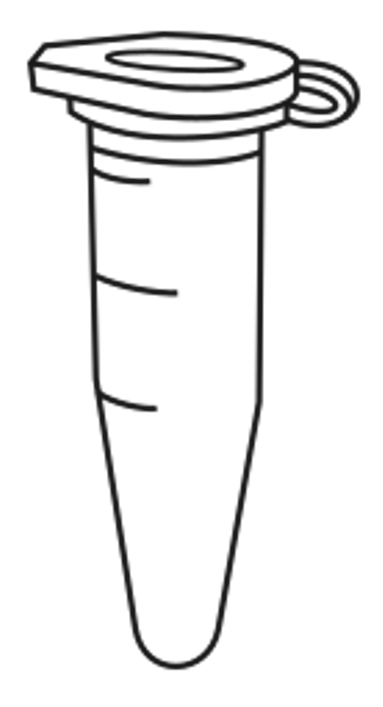
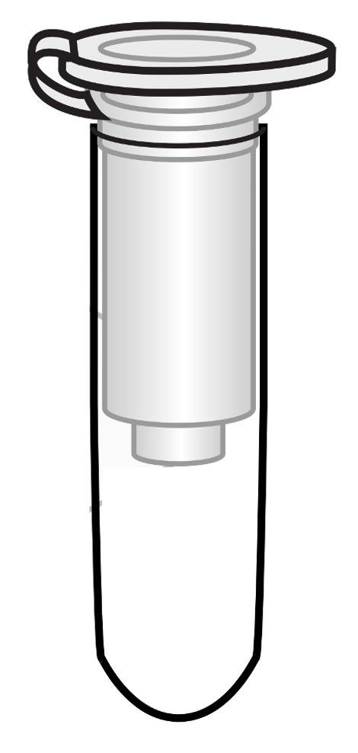
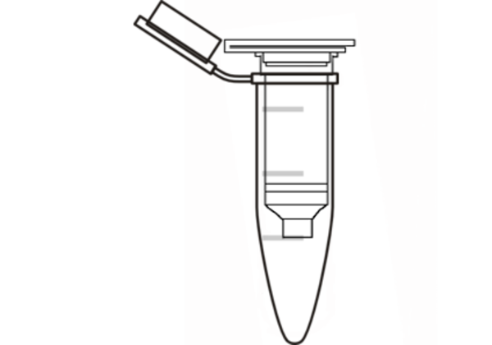
DNA Extraction Bench Protocol
This is an abbreviated protocol. Make sure to label all tubes and change pipette tips between samples.
Sample Preparation
Remove the abdomen of the arthropod and cut off a small piece (roughly ~2 mm, or small enough to fit in the bottom of a microcentrifuge tube). If the specimen is smaller than a grain of rice, use the entire body.
Place the specimen in a labeled 1.5 ml microcentrifuge tube.
Cell Lysis & DNA Precipitation
Add 180 ul Buffer ATL and use a sterile pestle to grind the sample for 1 minute.
Add 20 ul Proteinase K.
Add 200 ul Buffer AL and immediately mix by vortexing for 10 seconds or pipetting up and down.
Incubate for at least 15 minutes @ 56 °C. Longer incubation times (i.e., 2-3 hours) are most effective for cellular lysis.
If arthropod debris is present, do a quick spin (~30 seconds) to pellet debris. Use a pipette to carefully transfer the supernatant to a new labeled 1.5 ml microcentrifuge tube. Discard the tube of cellular debris.
Add 200 ul ethanol (96-100%) and mix by vortexing for 10 seconds or pipetting up and down.
Optional stopping point: store DNA in refrigerator (4 °C)
DNA Purification
Label a DNeasy spin column fitted with a 2.0 ml collection tube.
Pipet the liquid containing ethanol-precipitated DNA into the DNeasy spin column.
Centrifuge for 1 minute at ≥6,000 x g (8,000 rpm). Discard the flow through from the 2.0 ml collection tube.
Add 500 ul of Buffer AW1 and centrifuge for 1 minute at ≥6,000 x g (8,000 rpm). Discard the flow through.
Add 500 ul Buffer AW2 and centrifuge for 3 minutes at 20,000 x g (14,000 rpm).
DNA Elution
Transfer the spin columns to a labeled 1.5 ml microcentrifuge tube. Discard the 2.0 ml collection tube.
Pipet 100 ul of Buffer AE directly onto the spin column membrane.
Incubate at room temperature for 1 minute.
Centrifuge at ≥6,000 g or 8,000 rpm for 1 minute.
Discard the spin column and KEEP the labeled 1.5 ml tube.
Optional: incubate the DNA for 1 hour @ 65 °C or overnight at room temperature.
Store the eluted DNA frozen at -20 °C until PCR.
1.5 ml microcentrifuge tube
Spin column
2.0 ml collection
tube
Spin column
1.5 ml
microcentrifuge
tube
LAB 2: DNA EXTRACTION

